Slide 1
Why Crypto Wallet?
Notes:
Account hacked

Slide 2
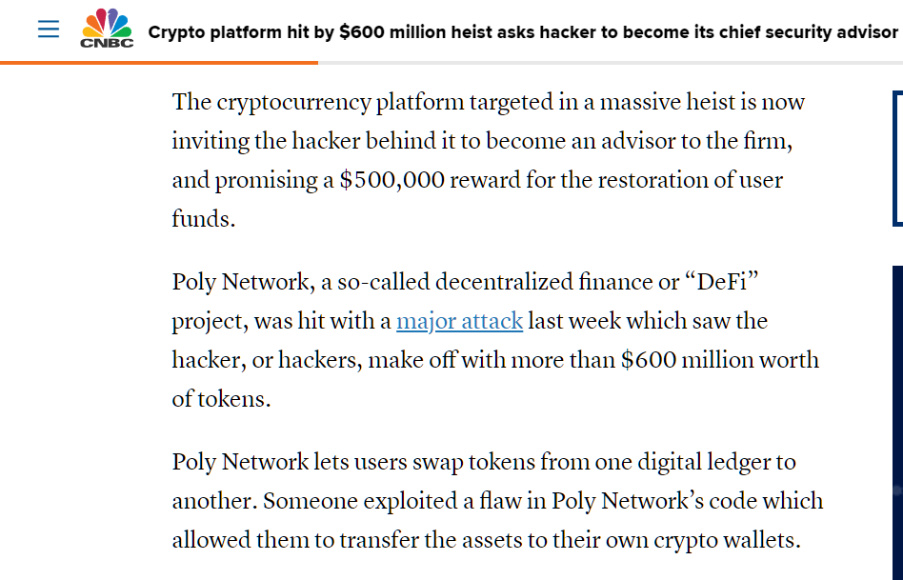
Notes:
Poly Network, a so-called decentralized finance or “DeFi” project, was hit with a major attack last week which saw the hacker, or hackers, make off with more than $600 million worth of tokens.
- Freeze the funds from the hacker’s (Mr. White Hat ) account.
- Poly Network had offered a $500,000 “bug bounty” to send all of the money back.
Hacker returned the money. The hacker initially turned down the bounty offer. However, in a message embedded in a digital currency transaction Monday, the hacker said “I am considering taking the bounty as a bonus for public hackers if they can hack the Poly Network.”
- Invite Mr. White Hat to be the Chief Security Advisor of Poly Network

Slide 3
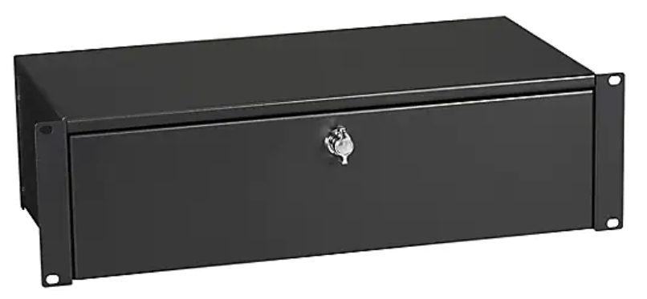
What is a cryptocurrency wallet?
Digital wallet
Keep track of balance, send, receive crypto
Single wallet, different currencies
Both crypto and tokens
Notes:
Crypto wallet is a digital wallet used for storing, sending, receiving digital currencies.
Some examples (Bitcoin, Ethereum, Dogecoin)

Slide 4
Crypto Keys
Crypto Wallet address (public keys)
Private Keys (recovery phase)
Crypto are not actually store in a wallet, instead, only private and public keys
Notes:
Crypto are not actually store in a wallet, instead, only private and public keys
Crypto do not have any physical form and cannot be store the same way as money can.
All that determines that one owns a crypto are records stored by the blockchain

Slide 5
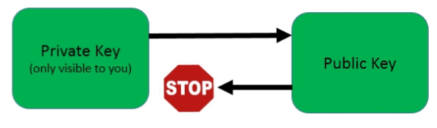
Create a new wallet
A private key (recovery phrase) is created.
A wallet address (public key) is created. Wallet Import Format (WIF)
Elliptical curve cryptography are mostly used to generate Private keys.
Notes:
Private key = a special hexadecimal code that is only known by the owner and the wallet. Shows that one is the owner of a certain Public Key.
Public key = what is connected to the amount of crypto that one holds.
If a private key is stolen, that person can then import the address to a wallet and transfer it to another wallet.
Public key can easily be generated from the Private key. It is a hash of the private key.

Slide 6
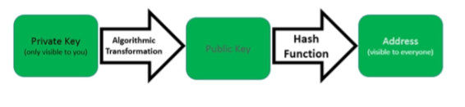
Create a new wallet
A private key (recovery phrase) is created.
A wallet address (public key) is created. Wallet Import Format (WIF)
Elliptical curve cryptography are mostly used to generate Private keys.
Notes:
A can have very many wallets address. One can use a new address of for every transaction.
Raven coin, a new wallet address generated after each transaction.

Slide 7

Exchanges
Change from one crypto to another.
Private keys are owned by the Exchange.
Notes:
Are platforms where one change from one crypto to another.
If Bitcoin owner see Bitcoin is not gaining value as fast as Ethereum, he can go to an exchange to convert Bitcoin to Ethereum.
Wallet is personal. Exchange is owned by another party.

Slide 8
Crypto wallet vs Exchange
Crypto Wallet
Exchange
Owned by you
You own the private keys
Receive and send crypto
More secure (offline)
Owned by a third party
Crypto owned by exchange
Receive, Send, and trade cryptos
Restrictions (withdrawal limits)
Notes:
Exchange owns the private keys. If the exchange were to disappear, the crypto you purchased is gone.
Crypto exchanges are not regulated.
If an exchange is hacked, the exchange is not required to compensate you.

Slide 9
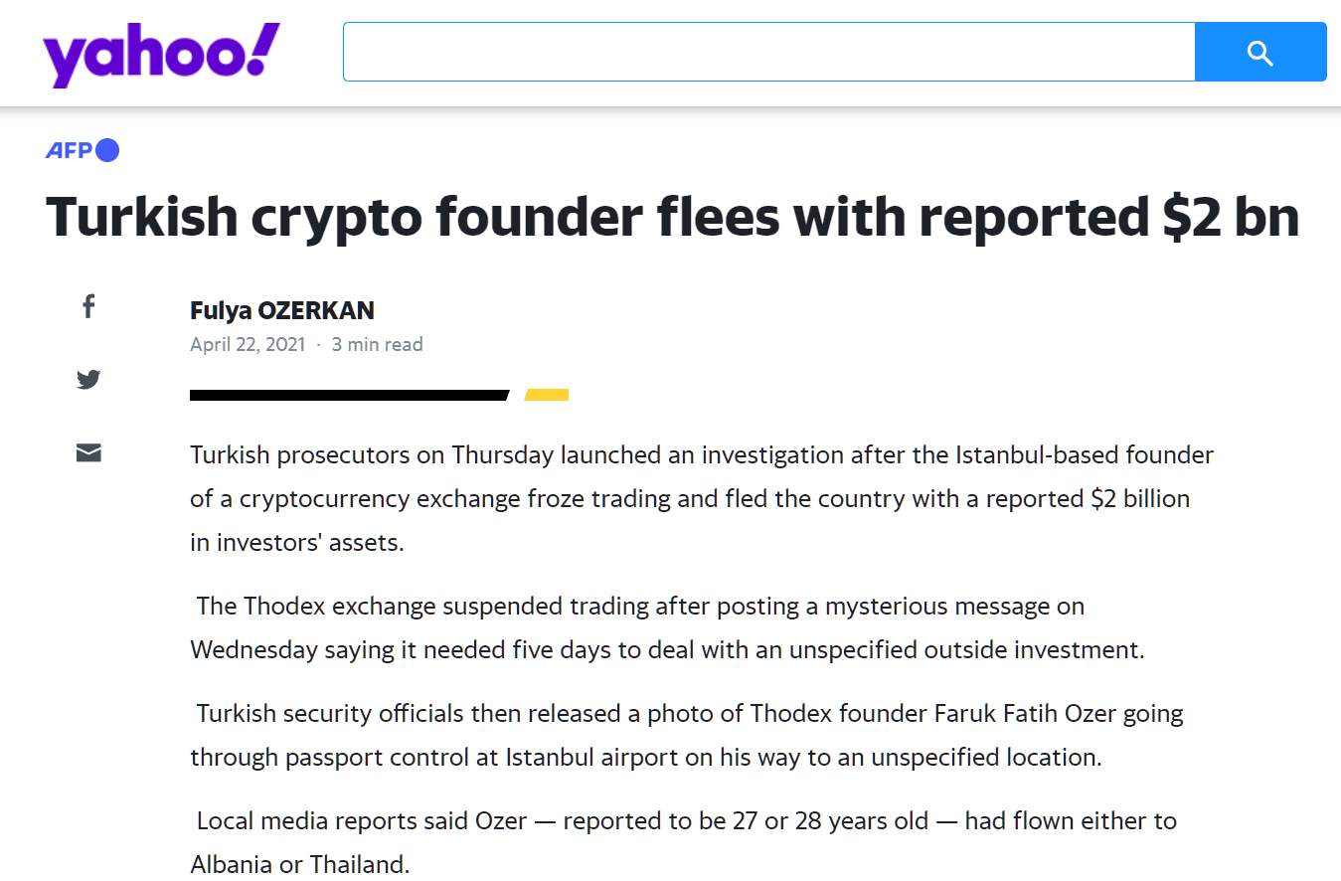
Notes:
https://www.yahoo.com/now/turkish-crypto-founder-flees-reported-141606649.html

Slide 10
Types of cryptocurrency wallets
Mobile
Web
Desktop
Hardware
Notes:
Desktop – run from your personal computer/laptop
Mobile – runs as apps on phone
Web – hosted on server from the internet
Hardware – on a device you physically have

Slide 11
Desktop Wallet (software)
Pros
Owns the private keys.
Restore wallet if required
Add additional security – antivirus, firewall, IPS, hard drive encryption
Option to disconnect from internet and stay offline
Cons
Defend against hackers from stealing private keys.
Cost of license for security products
Hard drive failures (back ups)
Blockchain updates
Must be on device to make transactions.
Software applications downloaded and installed on a computer/laptop
Notes:
Blockchain updates - Must connect to the internet to download the whole Blockchain each time one wants to make a transaction.

Slide 12
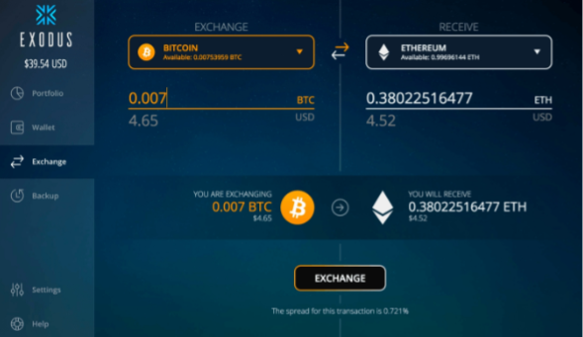
Desktop Wallet (software)
Exodus
Copay
Armory Wallet
Electrum
Etherwall
Notes:
Blockchain updates - Must connect to the internet to download the whole Blockchain each time one wants to make a transaction.

Slide 13
Mobile Wallet (software)
Pros
Same as Desktop Wallet
Offers portability
Cons
Same as Desktop
Less security products available than Desktop products
Software applications downloaded and installed on a phone
Notes:
Blockchain updates - Must connect to the internet to download the whole Blockchain each time one wants to make a transaction.

Slide 14
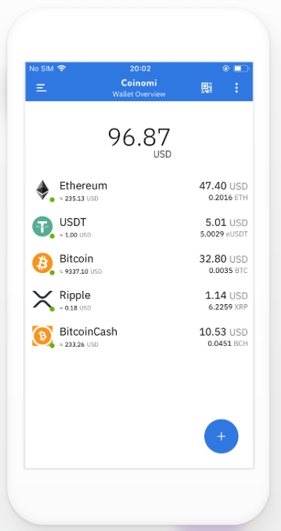
Mobile Wallet (software)
Coinomi
Enjin
Bread Wallet
Jaxx
imToken
Notes:
Blockchain updates - Must connect to the internet to download the whole Blockchain each time one wants to make a transaction.

Slide 15
Web-based Wallet (online)
Pros
Offers portability
Offers convenience of trading, sending, and receiving crypto
Cons
Security fears from many threats
Private keys own by third party
Runs on web browsers. Exchange wallets.
Notes:
Blockchain updates - Must connect to the internet to download the whole Blockchain each time one wants to make a transaction.

Slide 16
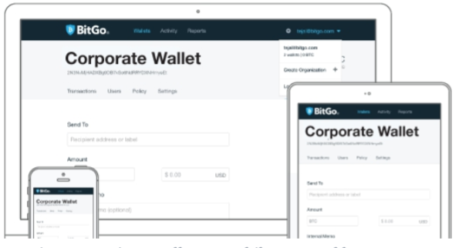
Web-based Wallet (online)
GreenAddress
BitGo
Coinbase
Binance
MetaMask
Notes:
Blockchain updates - Must connect to the internet to download the whole Blockchain each time one wants to make a transaction.

Slide 17
Hardware Wallet (offline)
Pros
Private keys stay on device
Restore wallet if required
Offers the most security (require hardware inputs)
Stays offline (connect to software online to make transaction)
Cons
Not free.
Lose crypto if locked out
Easy to misplace
Physical wallet kept offline.

Slide 18
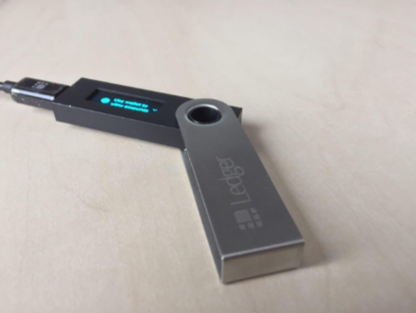
Hardware Wallet (offline)
Trezor
Ledger
Keepkey
Jaxx
imToken
Notes:
Blockchain updates - Must connect to the internet to download the whole Blockchain each time one wants to make a transaction.

Slide 19
Lessons Learned
No longer use Metamask
Mine to an Exchange (requires MFA)
Transfer funds from Exchange to Hardware wallet

